Slide 1
AUTONOMOUS CARS Article By Aman KumarJha
Deep Learning

Slide 2
Introduction
Autonomous Car Operates Without Human Involvement.They Rely On Cameras Sensors And Machine Learning Algorithms.
Building An Autonoumous Car Requires A Lot Of Processing Power To Execute The Software.
Like Humans The Self Driving Car Also Needs To See And View The Objects As Humans Do .Therefore The Cameras Used In The Cars Need To Be Properly Caliberated
Locating Cameras And Sensors At Different Parts Of The Car Will Help In Being Aware Of The Surrounding

Slide 3
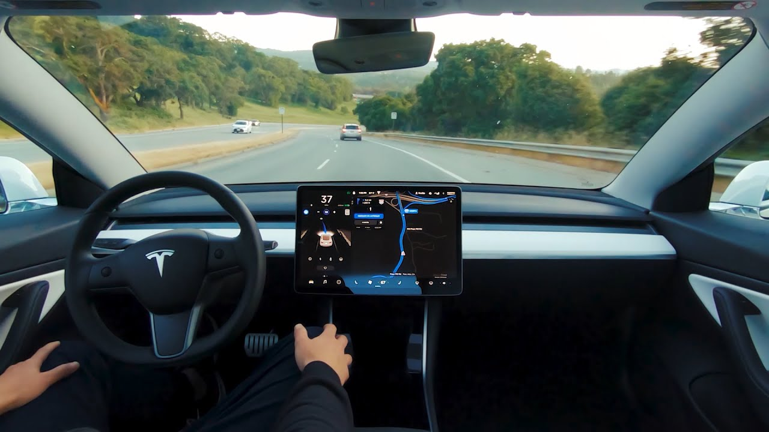
.

Slide 4
SENSORS
LiDAR : (LIGHT IMAGING DETECTION AND RANGING)
This Sensor Uses Infra Red Light Emissions In Predicting The Shape,Speed And Distance Between The Objects In Its View.
Cameras : However Good The Sensors Might Be, It Will Always Need A Vision To See The Objects As Good As Human Eyesight Or Sometimes Even Better. Here The Role Of Camera Comes Into Picture.
There Are Different Types Of Cameras Used At Different Parts Of The Car Which Will Be Necessary For Localization.

Slide 5
LEVELS OF AUTONOMY
LEVEL 0
1
LEVEL 1
2
LEVEL 2
3
LEVEL 3
4
LEVEL 4
5
LEVEL 5
6

Slide 6
Process
Perception
Localization
Planning
Control

Slide 7
PERCEPTION
Being Aware Of The Surroundings

Slide 8
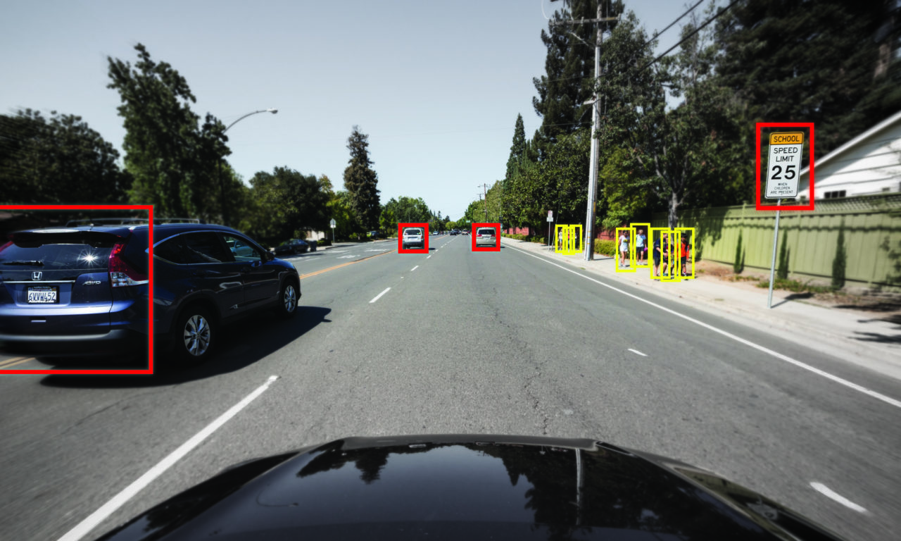
Perception
Notes:
8

Slide 9
LOCALIZATION
360 Render Of The Car Surroundings

Slide 10
Localization
Notes:
10

Slide 11
PLANNING
The Mind Of The Car To Take The Best Turns

Slide 12
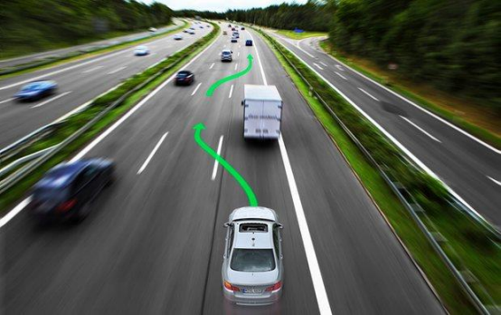
Planning
Notes:
12

Slide 13
CONTROL
Motional Control Over The Car

Slide 14
Control
Notes:
14

Slide 15
THANK YOU

